Slide 1
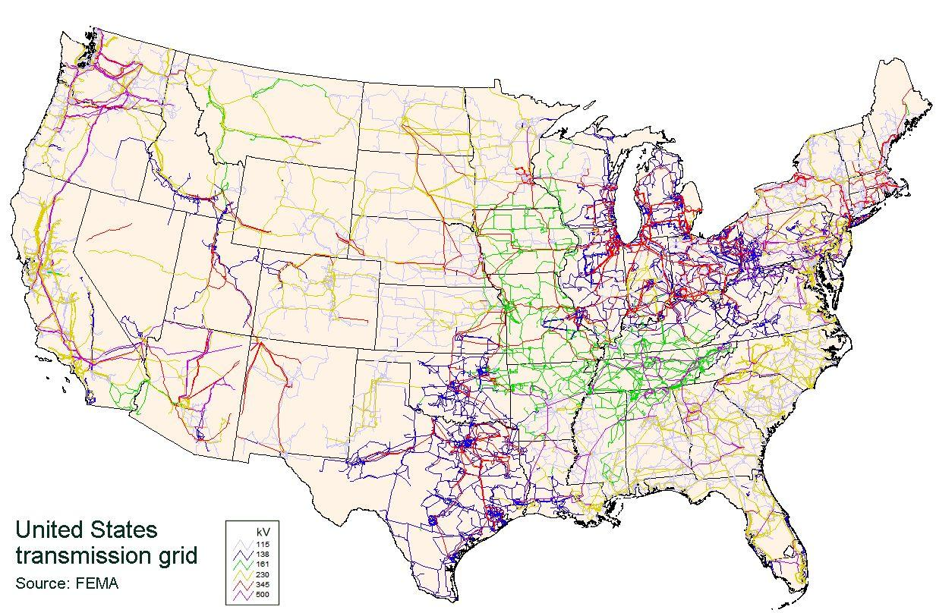
Power Grid Data Security
Chinese hackers temporarily gained full control of several US grid stations.
New security techniques must be implemented to prevent future attacks

